Slide 1
2025 RPD Poster Template Guidelines
Fill out information in top header area:
Poster Title
Your name, section number, and your postdoc job title (see list below)
  If you are a JPL postdoc employee, please use job title: JPL Postdoctoral Fellow
  If you are an NPP Fellow, please use job title: NASA Postdoctoral Fellow
  If you are a Visiting postdoc, please use job title: Visiting Postdoctoral Scholar
  If you are a JIFRESSE postdoc, please use job title: JIFRESSE/UCLA Postdoc
Your section number
Your advisor’s name and other collaborators and their section numbers
NOTE: Do not change the header (green) color as it is meant to highlight the postdoc posters during the event.
Content Area:
Be mindful of the judging criteria:
Original research contribution
  Does the poster clearly explain the postdoc’s individual contribution to the research? Specifically, where the postdoc’s research fits within the framework of the larger team project.
  Does the research contain novel concepts, theoretical frameworks, methods, or devices?
  Does the presenter's research offer the potential to introduce novel contribution or advancements to the field?
Communication
  Does the poster clearly convey the research's motivation and its alignment with broader JPL/NASA objectives? For example: What are the long-term goals of this work? If this research is successful, what JPL-relevant science/technology does this work enable?
  Does the poster outline a comprehensive plan for sharing this research with the wider community beyond JPL? Is there a clear strategy to showcase the work's significance?
  Is the poster succinct, yet comprehensive, designed to cater to an audience with varying levels of expertise? Can an individual from a different discipline easily comprehend the content?
Clarity of presentation
  Are the components of the poster organized in a logical flow, guiding the reader from background information to the research's significance?
  Are the components of the poster balanced across the poster, ensuring an even representation of components without overwhelming or underrepresenting any section?
Footer Area:
Gray Box to the right:
Add publications relevant to the work being presented. If no publications yet, indicate manuscripts in prep or submitted.
Add your contact information
To the left:
Add your Poster Number (refer to the list from the Postdoc Office, or to email received upon signing up (sent from Smartsheet, check your spam folder))
NOTE: Do not remove the copyright and NASA/JPL notations.

Slide 2

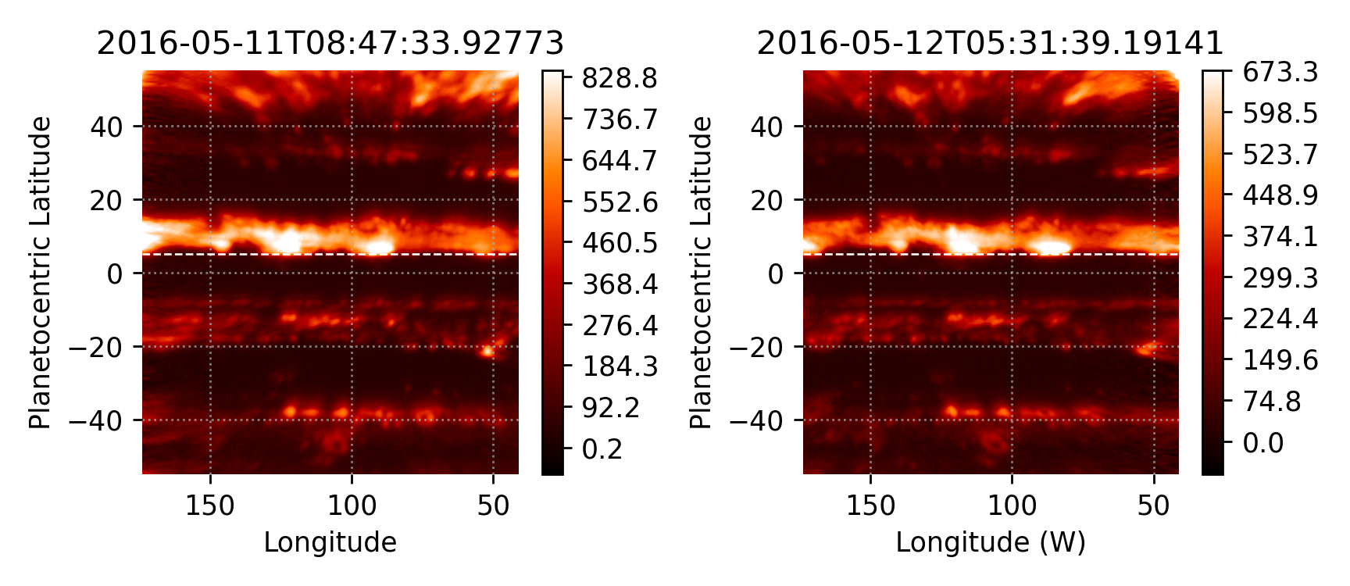
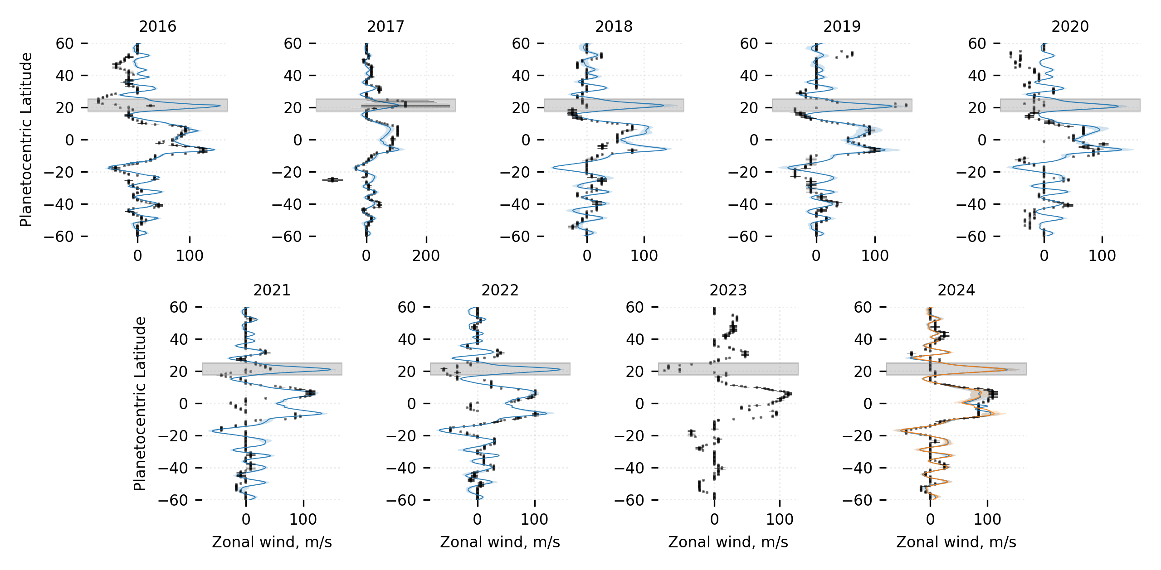
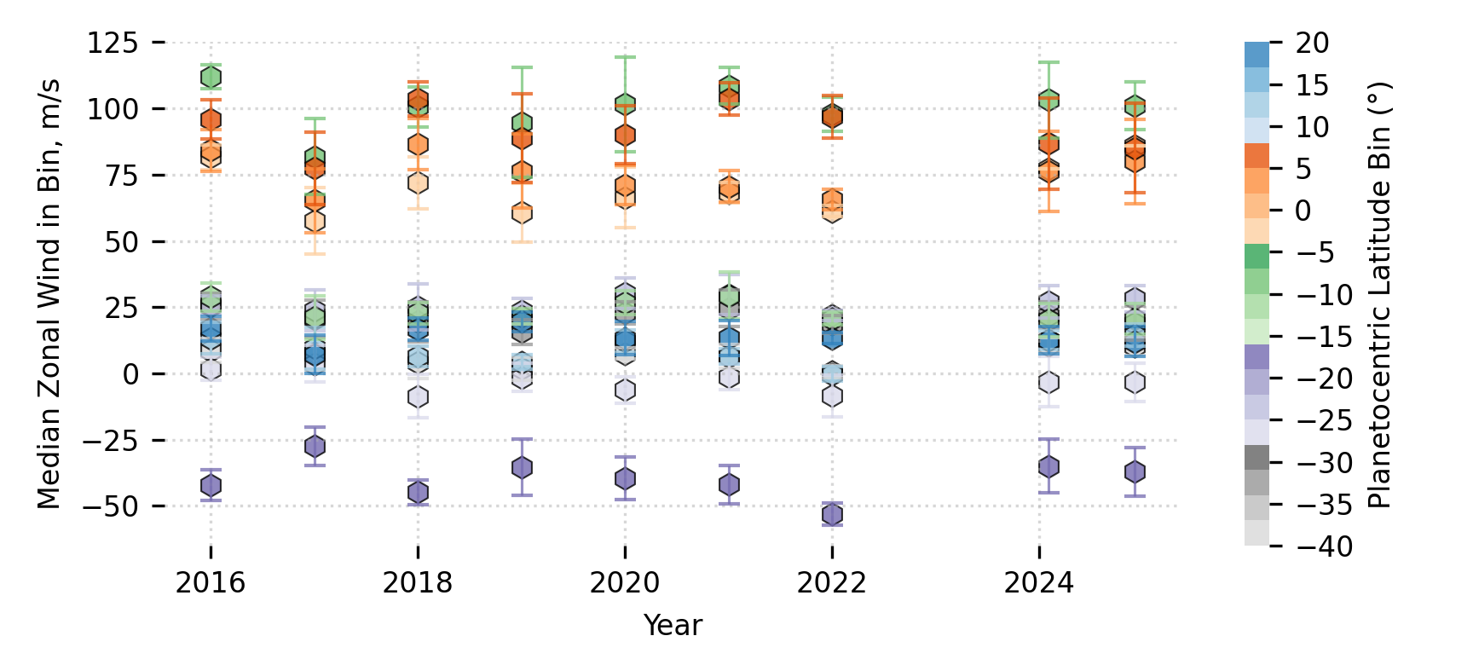
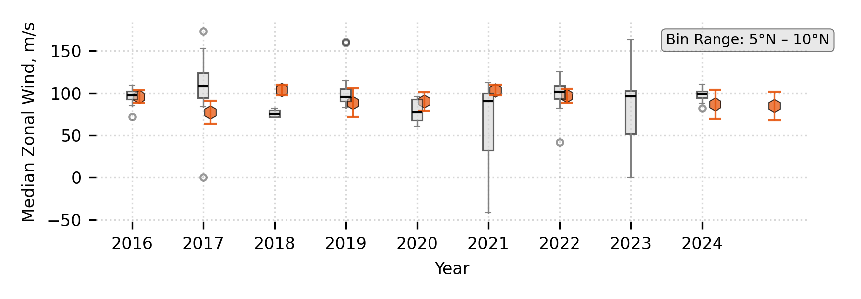
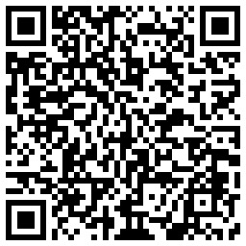
National Aeronautics and Space Administration
Postdoc Research
Deriving Jupiter's Zonal Winds using an Anti-Cloud Tracking Method
Author: Ali Hyder (Section 32, NASA Postdoctoral Fellow)
G. Orton¹, J. Sinclair¹, A. Simon², R. Morales-Juberías³
1. Section 32 2. NASA Goddard Space Flight Center, Greenbelt, MD 3. Department of Physics, New Mexico Tech, Socoro, NM
Background
(a)
(b)
Jupiter’s atmospheric circulation is dominated by strong zonal jets that occupy much of the equatorial and temperate regions up to about ±60˚ in latitude. They play an important role in shaping the tropospheric weather dynamics, and facilitate the zonal mixing of trace species and aerosols. Observations of the temporal and spatial variations of these zonal winds can help inform general circulation models (GCMs) that aim to simulate the interplay of instabilities integral to these zonal flows, facilitating our understanding of gas giant atmospheres.
Significant cloud cover
Jupiter’s thermal emission
as seen in the 5.1-µm range
Objectives
Constrain Jupiter’s zonal flow using IR data, supplementing space-based observational efforts such as the Outer Planetary Atmospheres Legacy (OPAL) program, as well as the Juno observations.
Demonstrate the use of an anti-cloud tracking technique, providing a novel methodology in constraining the dynamics of atmospheric motions.
HST-derived (binned) zonal winds
(c)
Figure 2. Panels (a) and (b) show NASA IRTF images taken during May 2016. The pair is approximately 21 hours apart, allowing us to map the longitudinal overlap and conduct a correlation analysis. Panel (c) shows IRTF derived winds (filled black squares) since 2016 as compared to the HST zonal wind profiles (solid lines). The gray regions denote areas that are 5-µm “dark” due to cloud cover and from which getting thermal-infrared data is difficult.
Figure 1. Jupiter zonal wind profiles for different latitude bins with a 5˚ kernel using Hubble Space Telescope data. The HST profiles were obtained through the OPAL program (Simon et al., 2015 + personal correspondence).
Results
We showcase Jupiter’s zonal wind profiles derived using long-term ground-based observations in the 5-µm spectral window using the SpeX instrument on the NASA Infrared Telescope Facility (IRTF).
Our preliminary analysis shows that the IR ZWP is in good agreement with the HST-derived wind profile.
Due to the high cadence of observations, we can quantify the temporal evolution of the planet’s ZWP, particularly during EZ-disturbance events.
Our approach can resolve temporal evolution of the zonal wind field, supplementing the HST observations (Fig. 1) and enabling analysis of the vast IR historical record spanning 1994 – 2025.
We can provide crucial context to Juno observations as the IRTF observations are contemporaneous with its perijoves.
Approach
We use image pairs that at are about 20 hours apart with a 1-hour margin [Fig. 2(a,b)]. These images are remapped using NASA Spice kernels to get the appropriate coordinates for the observation.
A latitude-by-latitude correlation is run on the overlaid maps, similar to the technique developed by Asay-Davis et al., (2008). Two methods are employed:
Sliding Window: Using the approach outlined by Johnson et al., (2018), a 45˚ window is used to step ‘West’ to get longitudinal variations.
Full Correlation: Same correlative method without the sliding window [Fig. 2(c)].
  Our approach can use episodic storms/longitudinal variations as anchor points to constrain the local zonal flows on Jupiter using ground-based observations.
  This effort directly supports the HST OPAL program and contextualizes the wind flows during the entirety of the Juno era.
  IRTF data span >2.5 decades worth of information relevant for wind evolution, enabling the creation of a new IR database that complements HST.
Significance
Future
Work
  We plan to extend this analysis to cover the full Jovian year.
  The IR wind profiles will be contrasted with the HST profiles during
  periods of overlap to quantify possible vertical shearing in Jupiter’s
  upper troposphere (an example is shown in Fig. 3).
  IR wind profiles will be made available on a public database (Hyder et al., in prep).
Figure 3. Sample HST evolution (hexagons) with binned IR data overlaid (interquartile ranges).
National Aeronautics and Space Administration
Jet Propulsion Laboratory
California Institute of Technology
Pasadena, California
www.nasa.gov
Asay-Davis, X. S., et al. Icarus 211, 1215–1232, 2011.
Hyder et al. (in prep), Deriving Jupiter's Zonal Winds using an Anti-Cloud Tracking Method.
Johnson, P. E., et al., Planet. & Space Sci. 155, 2–11, 2018.
Simon, A. A., Wong, M. H., and Orton, G. S., Astrophys. J. 812, art. #55, IOP, 2015.
The OPAL wind profiles can be obtained from MAST: https://archive.stsci.edu/hlsp/opal.
A. Hyder acknowledges the NASA Postdoctoral Program (NPP) for support for this project.
Author Contact Information:
ali.hyder@jpl.nasa.gov
Clearance Number: CL#00-0000
Poster Number: Postdoc-P-004
Copyright 2024. All rights reserved.
Get in touch!
Publications & Acknowledgments

